Slide 1
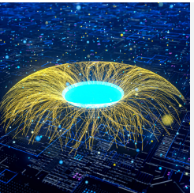
Gen AI-Based Data Profiling Solution for Regulatory Compliance
Automating Regulatory Reporting with AI and Machine Learning
Team Name – Runtime Terror
Team Members :
Sourav Mishra ,Nazeef Nazir, Ramesh Elika ,Ponnad Neeraja & Manjunatha A

Slide 2
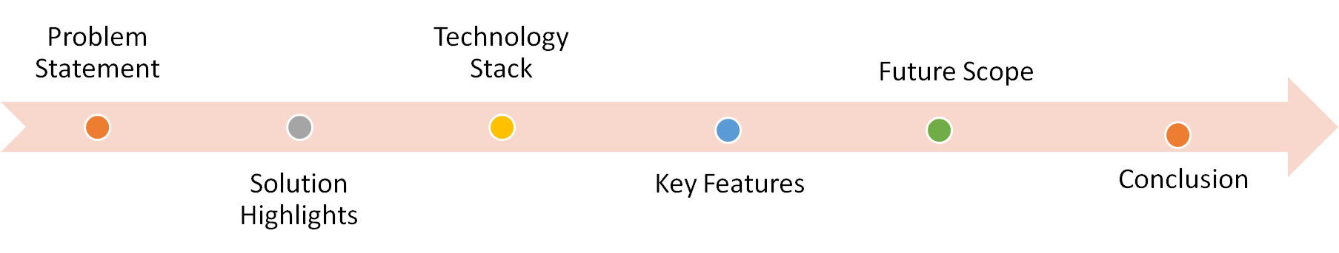
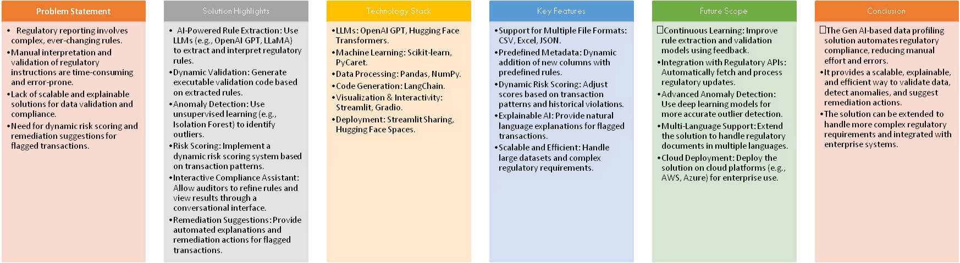
Design Approach

Slide 3
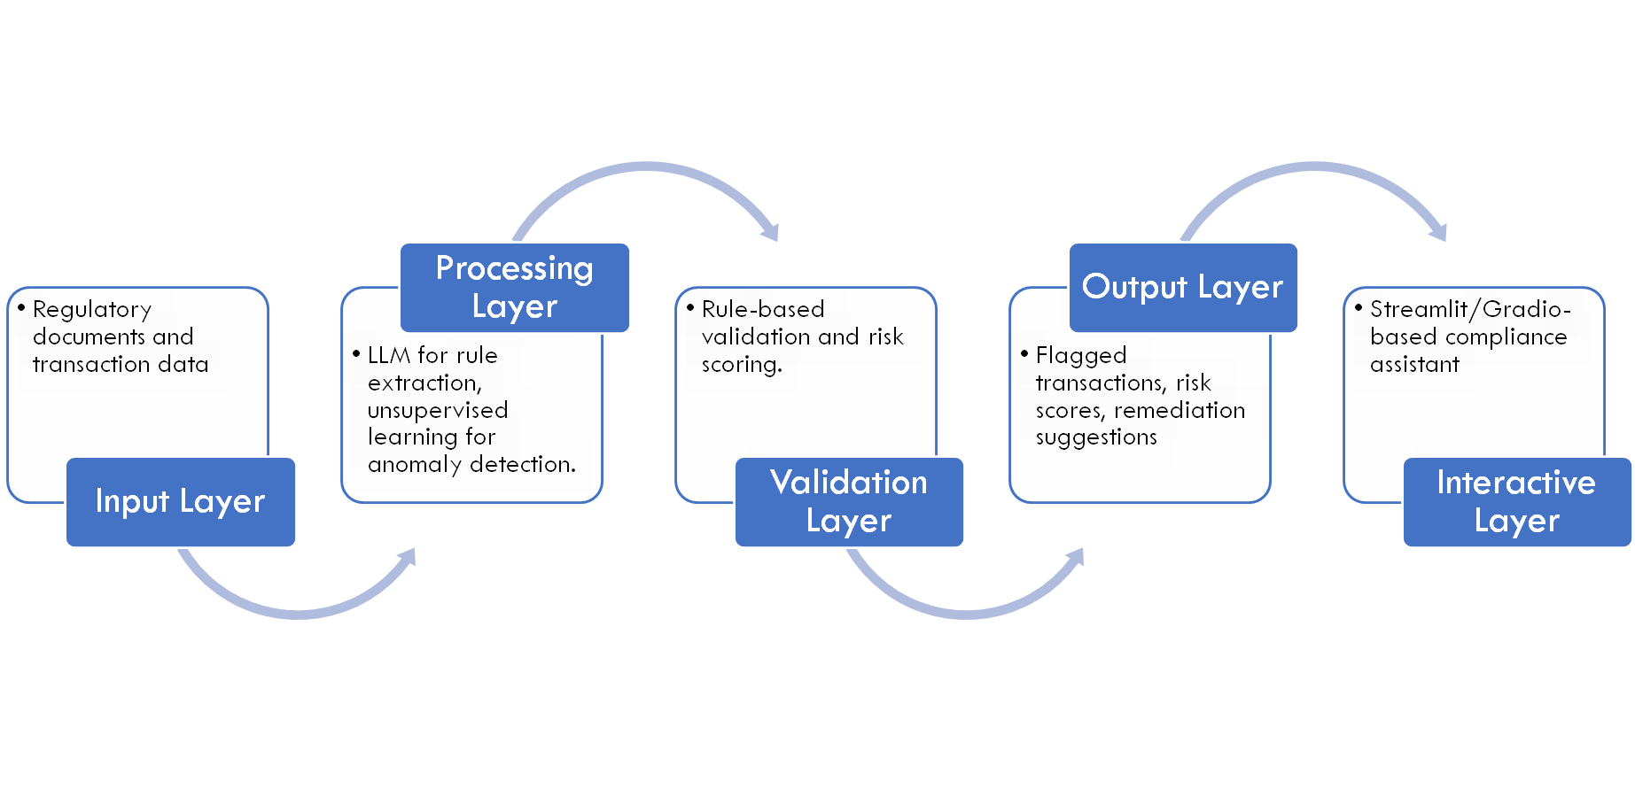
Solution Architecture

Slide 4
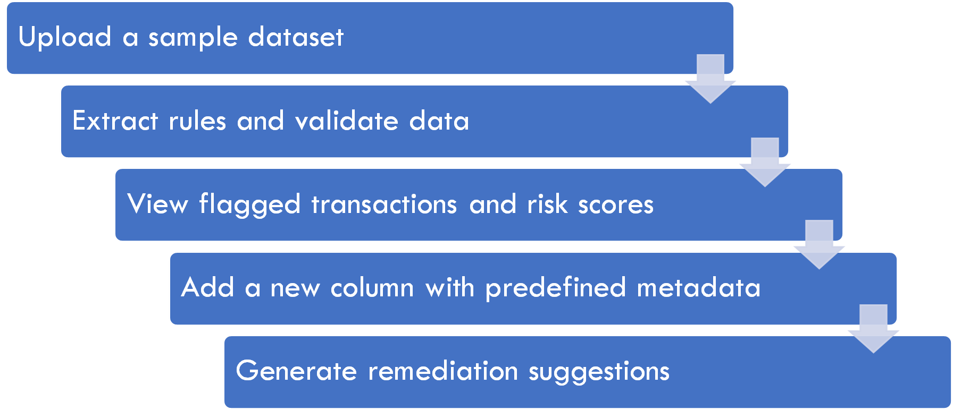
Demo

Slide 5
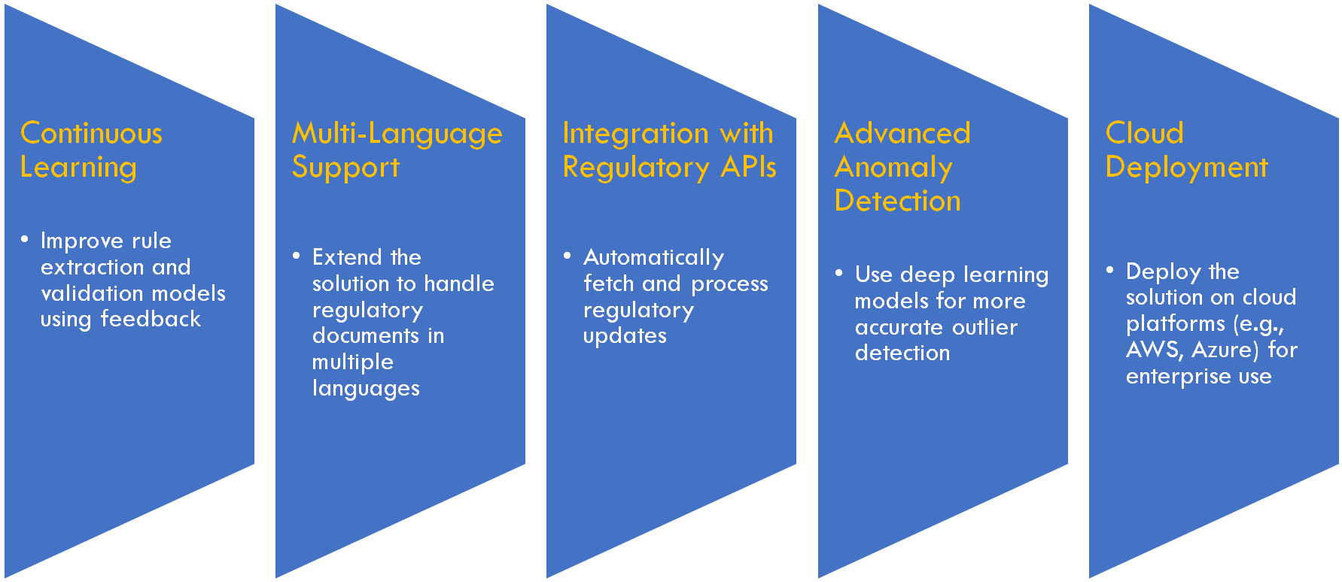
Future Scope

Slide 6
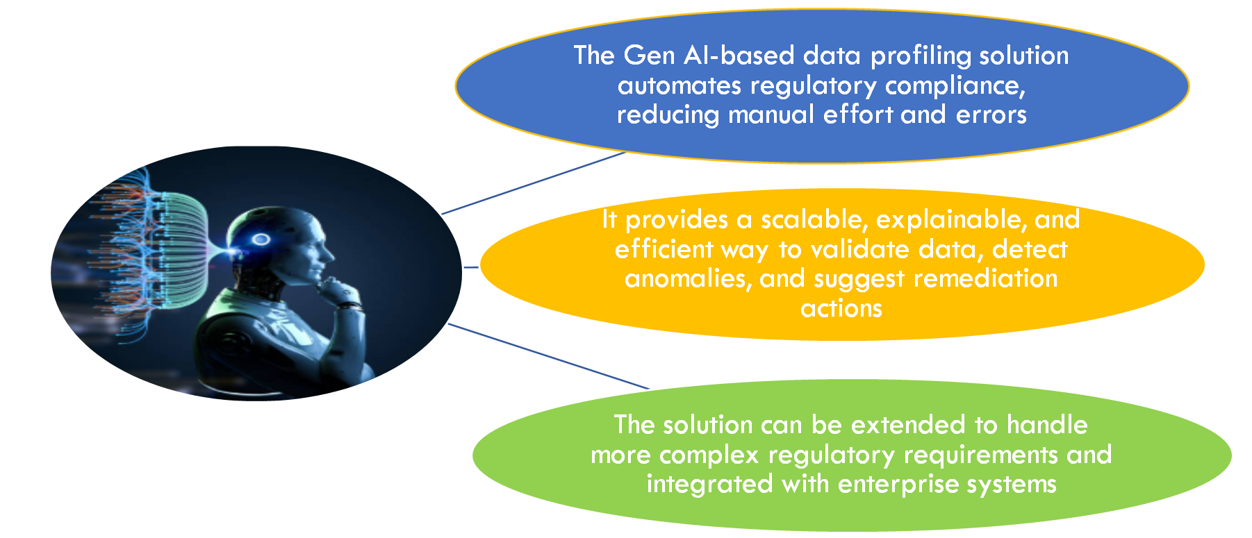
Conclusion

